Slide 1
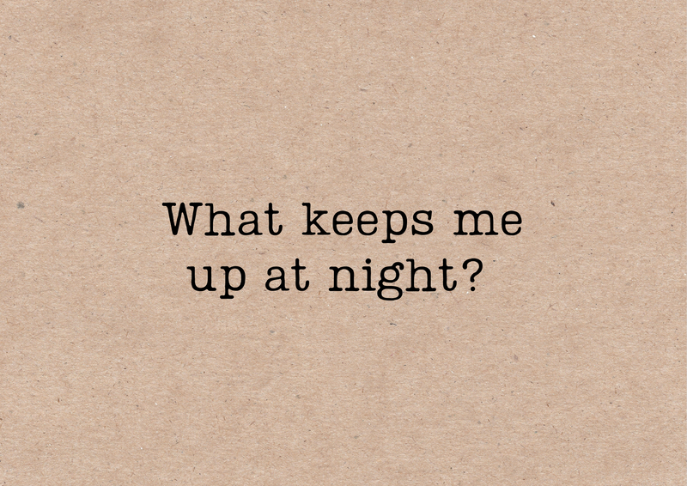
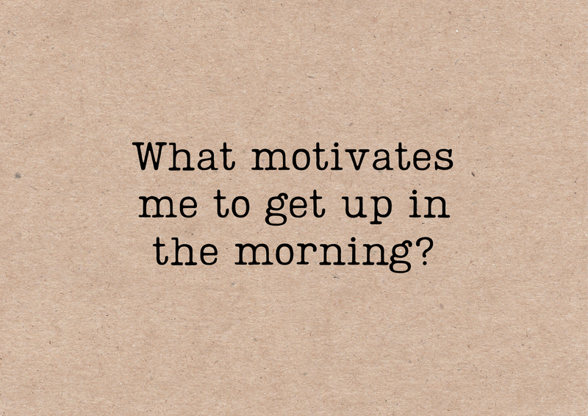
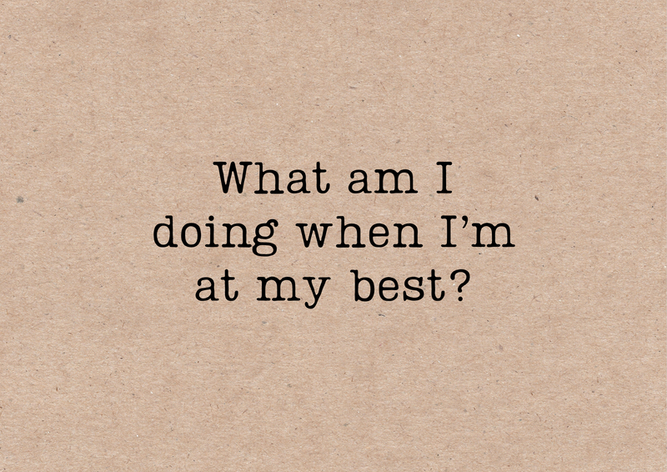






Brave
Bold
Brilliant
Did I have any intense emotions about my answers?
#reflection
www.franklyhuman.com
Notes:
Assuming participants haven't read the reflective questions.
A reminder that taking time to tune into our emotions is key to navigating and defining what is right for you.
Use your body and your emotion to guide your attention.

